Slide 1
Python Setup on Windows 10
Brian Linkletter
2018
Notes:
Welcome to this update for the NokiaEDU Cloud Lab project. Today, we will explain how NokiaEDU will use new technology to run our virtual training labs in the cloud, even though some Nokia products are not compatible with public cloud technology.
We'll also explain why we are now planning to use Microsoft Azure as our primary cloud vendor. (*)
A good description of the importance of using nested virtualization in technical training labs
https://turbonomic.com/blog/on-technology/a-quick-guide-to-nested-virtualization/
A good overview of the technical challenges of making nested virtualization work in an OpenStack cloud
https://www.stratoscale.com/blog/openstack/nested-virtualization-openstack-part-1/
https://www.stratoscale.com/blog/openstack/nested-virtualization-openstack-part-2/
Recent news that shows that nested virtualization is ready to use in the cloud starting late 2017
https://www.theregister.co.uk/2017/08/27/kvm_plans_big_boosts_to_storage_and_nested_virtualization/
https://azure.microsoft.com/en-us/blog/nested-virtualization-in-azure/
https://blogs.oracle.com/cloud-infrastructure/nested-kvm-virtualization-on-oracle-iaas
https://cloudplatform.googleblog.com/2017/09/introducing-nested-virtualization-for.html
Technical details
https://medium.com/oracledevs/nested-kvm-virtualization-on-oracle-cloud-infrastructure-5559bdd2213d
https://cloud.google.com/compute/docs/instances/enable-nested-virtualization-vm-instances
https://docs.microsoft.com/en-us/azure/virtual-machines/windows/nested-virtualization

Slide 2
Requirements
Simple, lightweight system
We are beginners; we do not need a complex environment
Must work when computer is:
Inside Nokia intranet, at the office
On the Internet, at home or in a coffee shop
Must follow Nokia rules to avoid illegal software

Slide 3
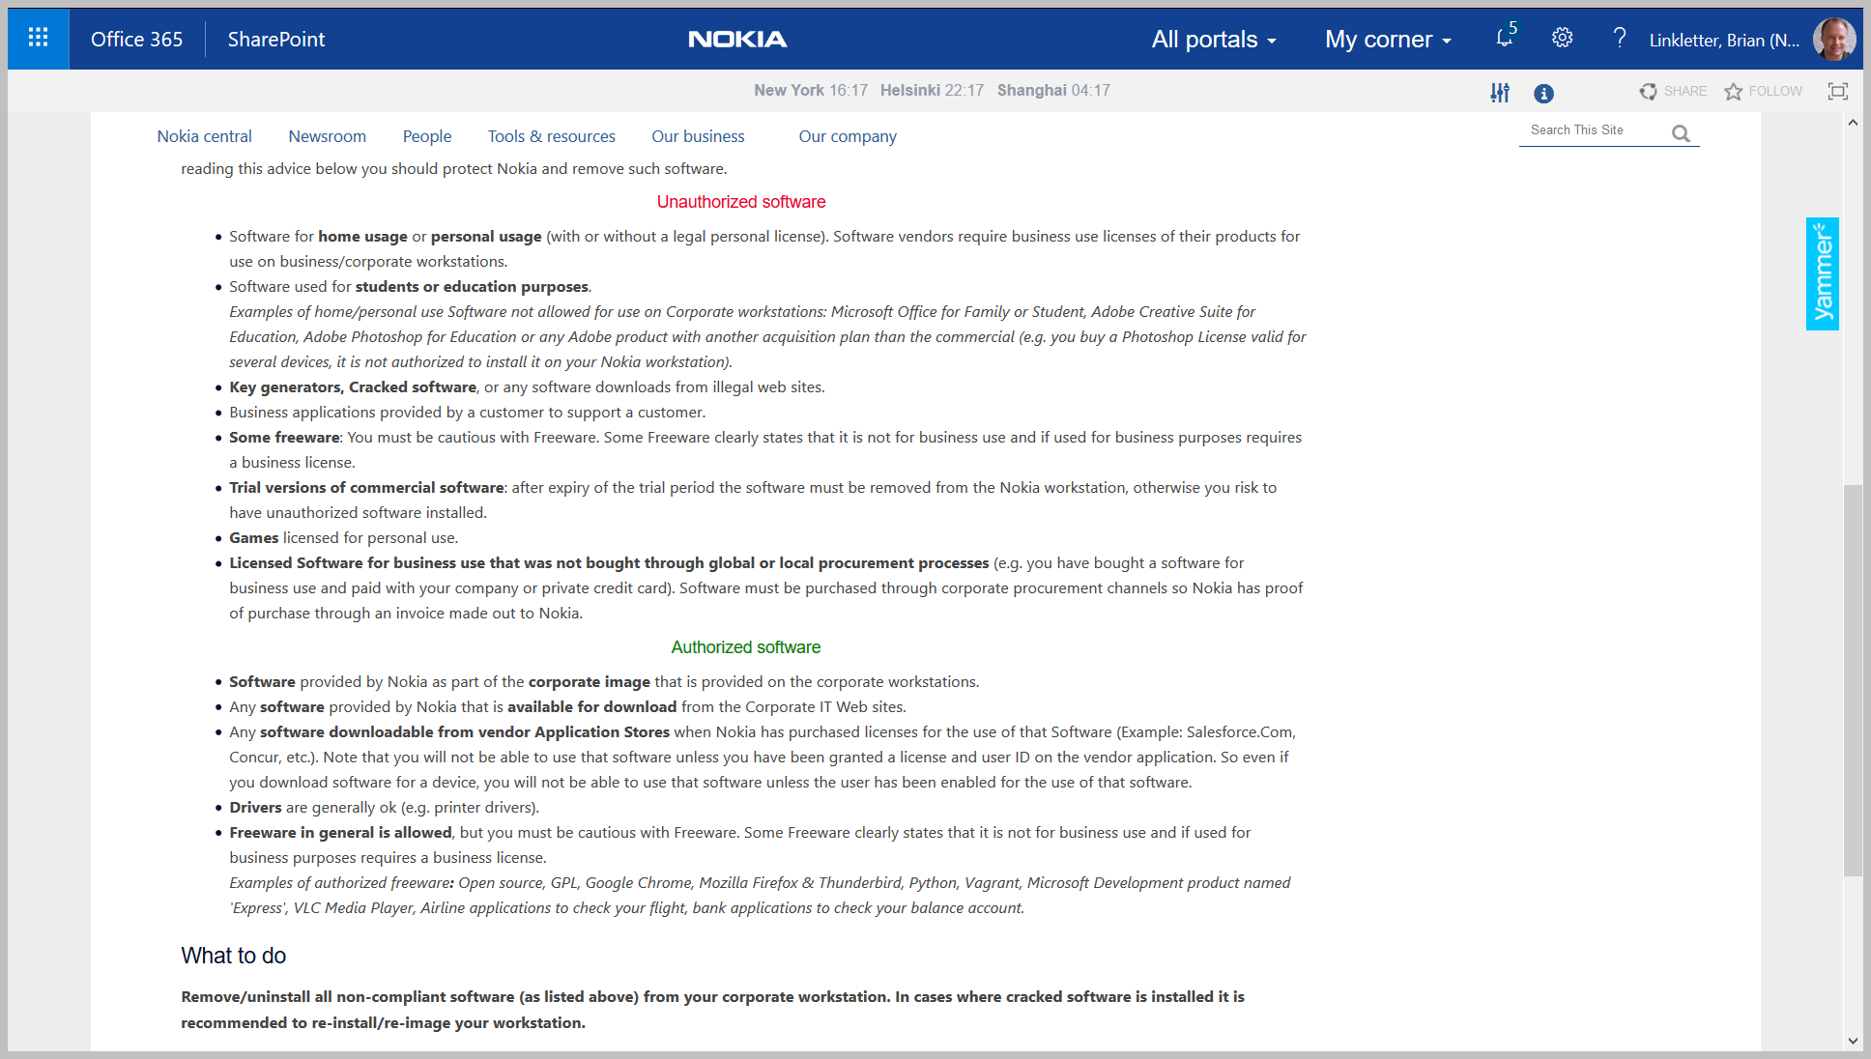
https://nokia.sharepoint.com/sites/news/2017/Pages/Things-to-know-about-illegal-use-of-software-on-Nokia-workstations.aspx

Slide 4
Software rules summarized
Avoid illegal software
Personal use license may not permit business use
Free versions of software may only be for personal use
Freeware, in general, is allowed
But, it must be truly free
Open-source software is acceptable as freeware
GPLv2, GPLv3
BSD, MIT, Apache

Slide 5
Install Python

Slide 6
Nokia resources
Official Python support for Nokia developers
Official support = WinSEE
WinSEE provides licenses for a large number of development tools.
Includes PyCharm Professional and Python 2.7.
Try WinSEE Web Portal to pick only the tools you need.
Lots of professional-grade software for developers
Created by MN for Radio technology BTS product development
Limited number of licenses for the professional development tools
But, I only want basic Python, and I want the latest version
I will download the open-source Python 3 from the Python web site

Slide 7
Install Python 3
Download Python for Windows from the Python install page
https://www.python.org/downloads/windows/
Download the windows installer for Python 3
Ensure you install the 64-bit versions:
https://www.python.org/ftp/python/3.6.4/python-3.6.4-amd64.exe
Run the installer

Slide 8
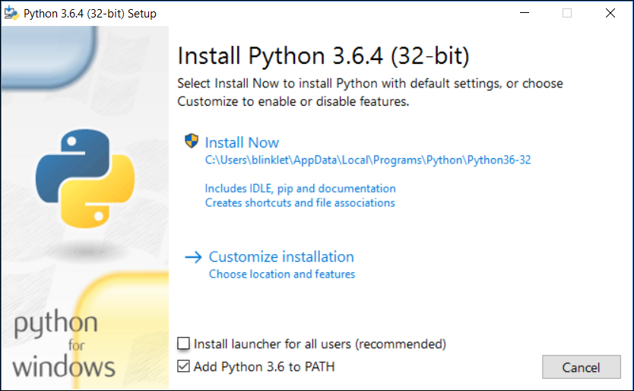
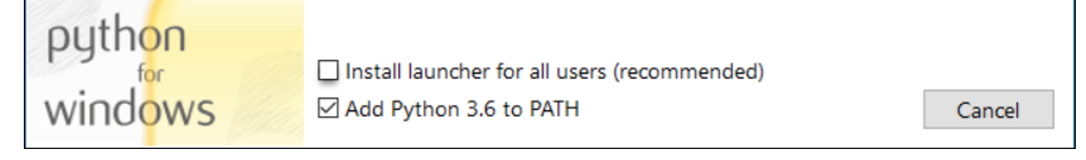
Install Python 3
Install Python for just your own user, to avoid requiring admin privileges
Add Python to PATH
Click Here

Slide 9
Proxy Servers

Slide 10
Nokia Proxy Server
No easy solution
Nokia’s proxy server blocks connections from PIP, Python’s package manager
PIP cannot install new Python packages
User cannot create Python virtual environments
Nokia Repositories
One solution is to use Nokia repositories at CSF site:
Mirror of external repos inside Nokia’s network
But, mirrored repositories not accessible from Internet

Slide 11
Solution
Simple and non-permanent
Default setting: PIP works when connected to Internet
When in Nokia network, set HTTP Proxy server manually
Change only impacts the currently open command window so it is harmless
Change only lasts while the command window is open.
If you close the window and open another window, you must set the proxy again
Works in CMD and in PowerShell
This is the easiest solution for beginners

Slide 12
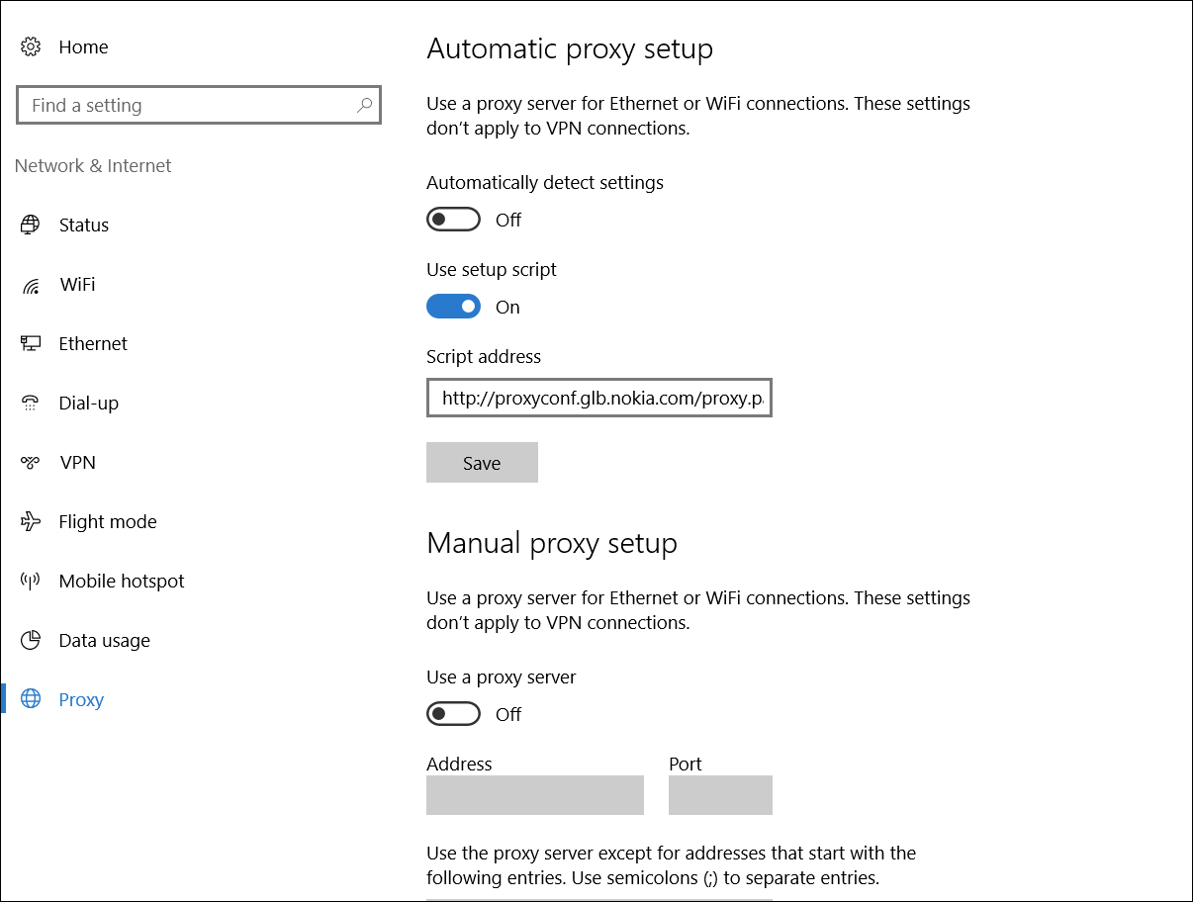
Find IP address of your proxy server
Open Windows proxy settings
Copy URL of automatic proxy script address
Paste into Browser window
Save file to local drive
Open in text editor
Find local proxy IP address and port
Look for text: ‘var proxy="PROXY’
Copy URL

Slide 13
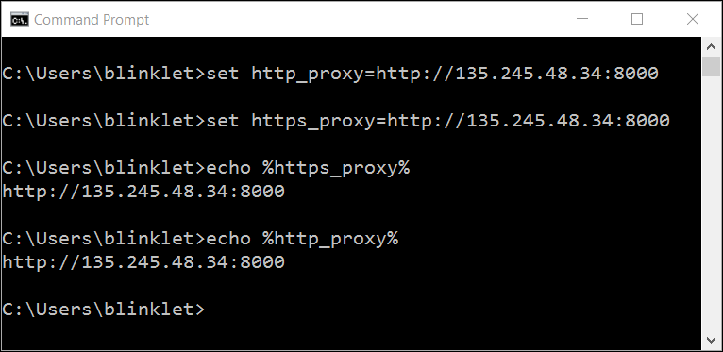
Set HTTP and HTTPS proxy in command window
When you are inside Nokia corporate network or on VPN
Windows CMD window:
Use set command
Verify with echo command

Slide 14
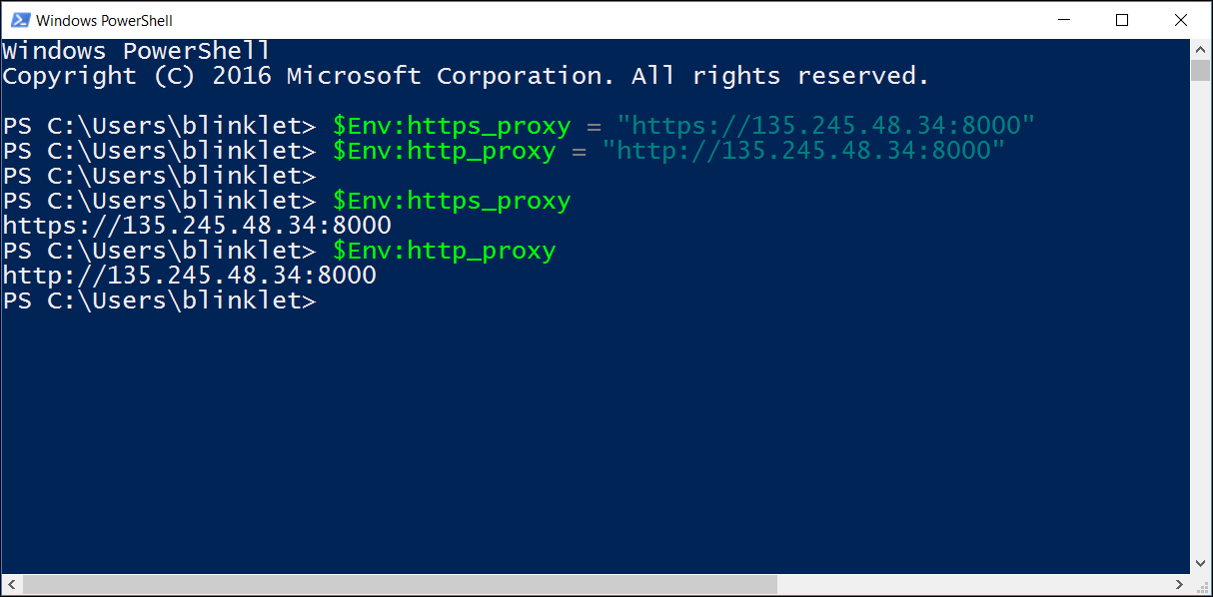
Set HTTP and HTTPS proxy in command window
When you are inside Nokia corporate network or on VPN
Windows PowerShell window:
Use $Env: command
Verify with $Env: command

Slide 15
Alternative solution
Set proxy in PIP config file
Set up the pip.ini config file
The location depends on how you installed python.
We installed Python only for one user
The pip folder must be created in the folder specified by the user’s APPDATA environment variable.
For PowerShell:
> $Env:APPDATA
Or, for Windows Command Prompt:
> Echo %APPDATA%
In our case, the APPDATA variable value is
C:\Users\username\AppData\Roaming

Slide 16
Set proxy in PIP config file
When you are inside Nokia corporate network or on VPN
Create the file:
C:\Users\blinklet\AppData\Roaming\pip\pip.ini
Add your local proxy server to the file:
[global]
proxy = https://135.245.48.34:8000
Now the pip and virtualenv commands will work on the corporate network
When on Internet, rename pip.ini file to something else so pip does not use it.

Slide 17
Text Editors

Slide 18






Text editor
Which one?
Many open-source text editors are available
Use your favorite
NotePad++ is good
Available in Nokia Software Centre
But, get latest version from web site
Great for solo projects
Microsoft Visual Studio Code
Works on all major platforms
Better for team projects

Slide 19
Text editor
Install Microsoft Studio Code
Go to Microsoft Studio Code web site
https://code.visualstudio.com/
Download installer, run installer, and follow instructions
Start VS Code
It will ask you to download Git
Clear the box, for now. We may use Git later.
Get started
https://code.visualstudio.com/docs?start=true

Slide 20
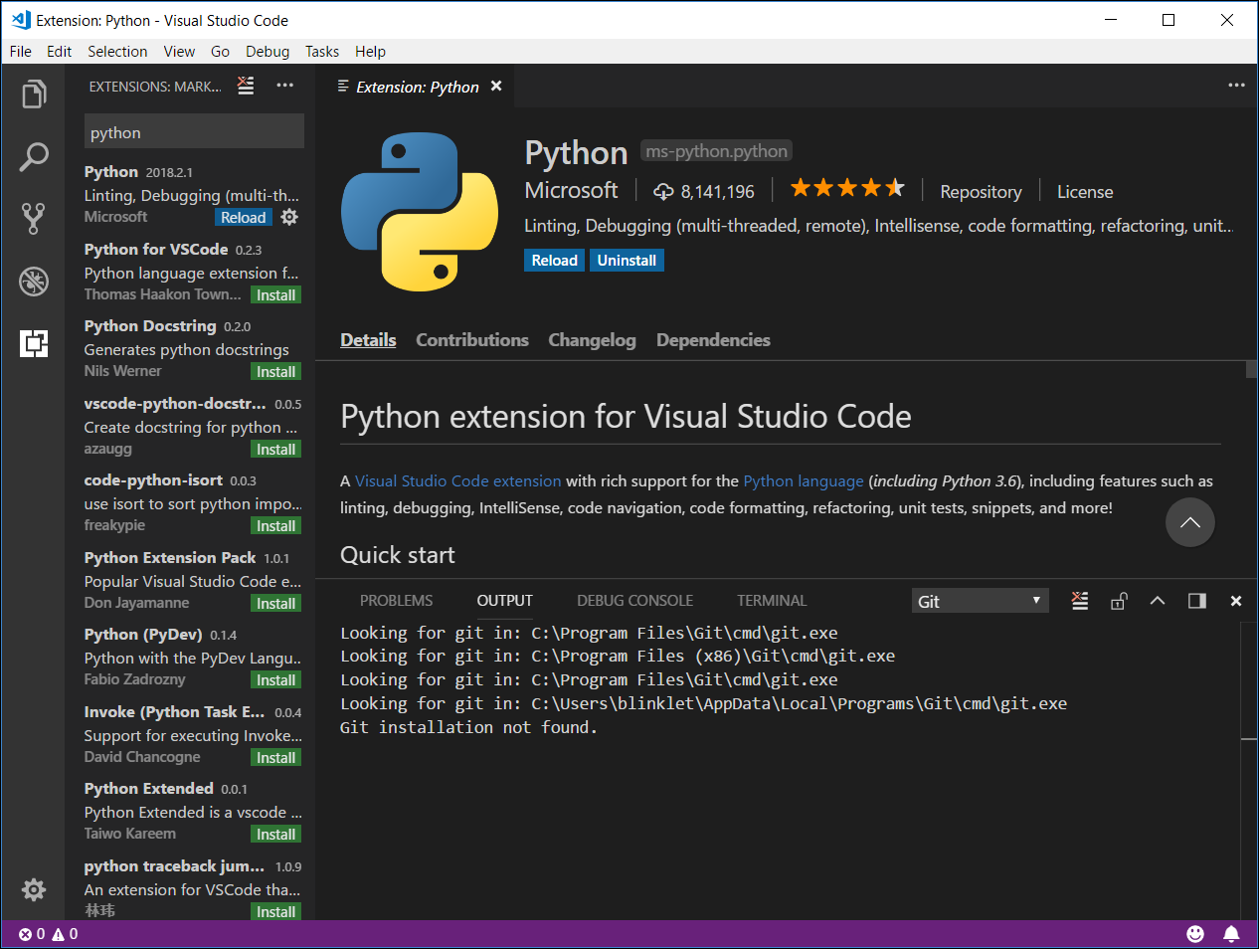
Set up Python Extension
Microsoft Studio Code
Click on the “Extensions” icon or use the menu command:
View → Extensions
Install the Python extension from Microsoft
Install other extensions if needed:
Hyperledger
Ansible
Azure extensions…

Slide 21
Learning Python

Slide 22
Learning resources
Many resources available online, on Safari, and on LinkedIn Learning
Pick any that appeals to you
My current personal preferences are the following free books:
Dive into Python 3
http://www.diveintopython3.net/
Automate the Boring Stuff with Python
https://automatetheboringstuff.com/

Slide 23

Notes:
(*) And that is the end of our update. Thank you for your attention and have a great day.

